Slide 1
Discovering your Norwegian Family History
Marisa Benson
Thief River Falls, Minnesota
October 14, 2024

Slide 2
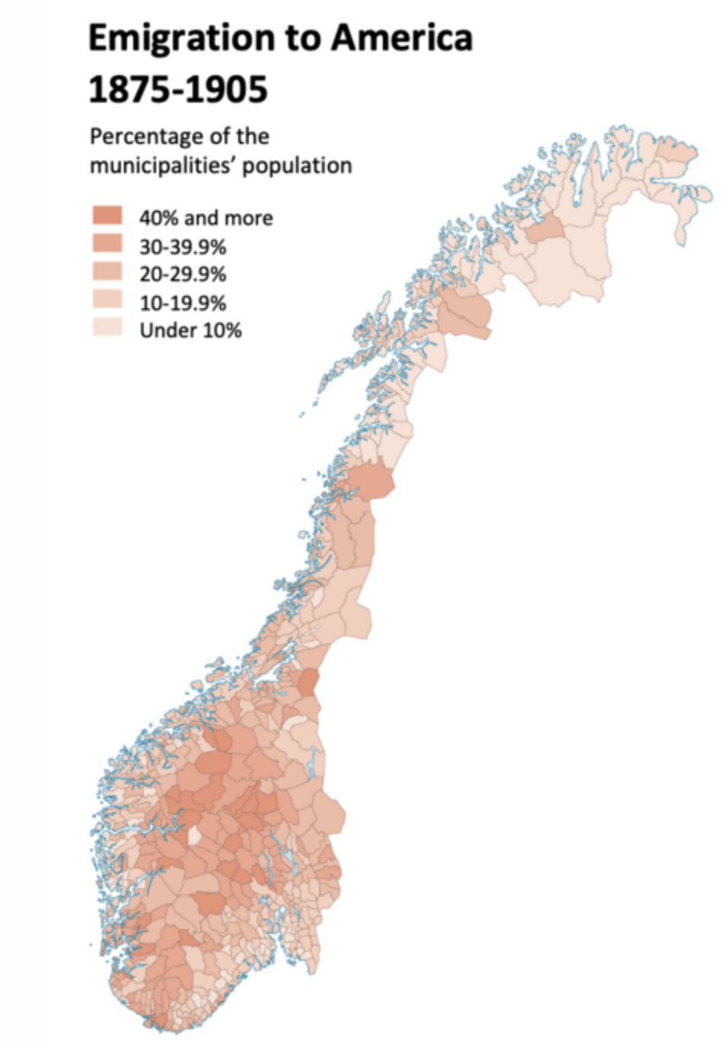
Norwegian Emigration
The first organized emigration starts in 1825 and reaches its peak in the 1880’s
Although Sweden sent more emigrants to the United States than any other Scandinavian country, Norway sent a greater percentage of its population: nearly 1 million people from 1820 to 1920… Norway lost a higher proportion of its people to the U.S. than any other country than Ireland.
Library of Congress: “The Norwegians”

Slide 3
Why?
Between 1800 to 1850, the Norwegian population increased by 59%.
Only 3% of Norwegian land is arable and even well-established farmers struggled to give land via inheritance to all their children.
Norway’s economy was hit hard from mid-1870s to the early 1890s.
  International slowdown, especially in the UK
  Adoption of the gold standard in 1874 with a huge contraction in reserves and deflation
  Slow transformation from sailing to steam vessels due to lack of capital and technological skills
Ola Honningdal Grytten
Norwegian School of Economics and Business Administration

Slide 4
Norwegian Internal
Migration
From 1800 to 1914, the Norwegian population moved from the countryside to the towns but also up to northern Norway.
A significant number of people moved north from overpopulated areas such as Voss, Gudbrandsdalen, Østerdalen, and Trøndelag.
Norgeshistorie.no / University of Oslo

Slide 5
Norwegian Emigration
Before 1875
  Mostly families and often farm owners
  Usually not destitute: early travel was not cheap!
  Tended to move to the same U.S. destination
1875-1915
  Individuals began to emigrate
  Often pre-paid tickets from the U.S.
  Travel back and forth – often annually

Slide 6
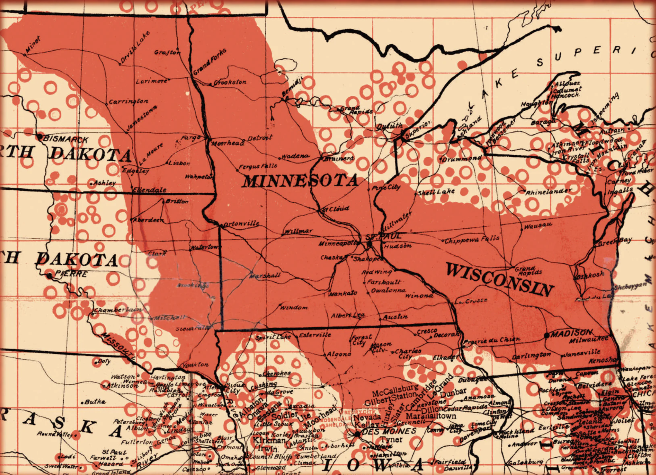
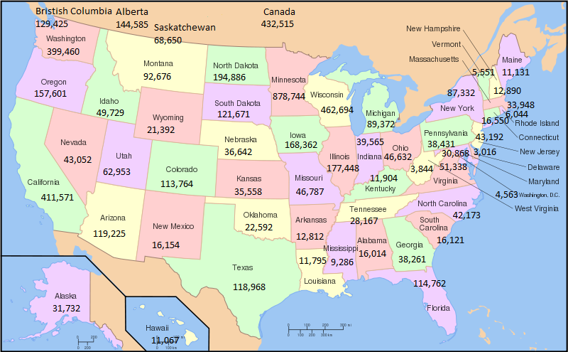
Settlement Patterns
  New York
  Illinois (Fox River)
  Wisconsin
  Iowa
  Minnesota
  Dakotas
  Canada

Slide 7
Ships and Arrivals
Non-Scandinavian owner
Most left from Liverpool
Many sailed directly to Quebec or Nova Scotia
Ellis Island (1892-1954) is not a useful starting place to trace Norwegian arrivals!
Be careful: many later emigrants traveled back and forth to Norway and could have multiple immigration records.

Slide 8
Norwegian Names
Patronymics used until late 19th century
  Olaf Torkelson was Torkel Anfinson’s son
  Ragnhild Olsdatter is Ole Jenson’s daughter
Farm names (gårdnavne) often added to the first name and patronym; originally an address rather than a surname
  Ole Einarson Ormseth marries Ingri Olsdatter Viken, moves to her farm and becomes Ole Einarson Viken
1923: Everyone in Norway had to decide on a hereditary last name that would pass down the generations
  65-70% of Norwegians today have former farm names like Berg, Hagen, and Lie.
  Top ten Norwegian surnames in 2013: Christiansen, Sunde, Mortensen, Thoresen, Bjerke, Torgersen, Hermansen, Mikalsen, Magnussen, Nilssen

Slide 9
Spelling Choices
Records were not written by the people but by civil servants or clergy
Spelling varied with the spoken dialect
  Sigurd, Sivert, Syver, Siur, Sjur are all the same person in a variety of records in Sogn og Fjordane
  Three brothers from the Storviken farm: Viken, Wiken, Vigen
Family members chose different surnames
  John A. Dahl and Ludwig Anderson
Americanized names
  Aslaug = Ellen
Some changed their own name back and forth!
  Ole T. Anfinson = Ole Torkelson

Slide 10
Naming Children
Oldest son = paternal grandfather (farfar)
Second son = material grandfather (morfar)
Oldest daughter = paternal grandmother (farmor)
Second daughter = material grandmother (mormor)
Third and subsequent children after deceased spouse/parent
If the oldest or second child dies, the next child is given his or her first name.

Slide 11
Start with what YOU know
Not the family stories
Not the online personal histories
Not Rootsweb or FamilySearch

Slide 12
Know a bit of Norwegian
Fylke/amt = county
Førnamn = first name
Etternamn = last name
Bønder = farm owner
Huseman / husmann = cotter/smallholder
Innerst = person renting a dwelling on the land
Kone = wife
Barn = children
Gift = married (ugift = single)

Slide 13
Know a bit of local history
New counties and name changes
  Polk -> Red Lake -> Pennington
Townships have numbers before they have names
  Township 153 = Smiley (Richbury)

Slide 14
Census Records: archives.gov
Released after 72 years: 1950 is latest full release
Watch for mistakes and illegible writing
Families often live close to each other
1890 Federal Census: Burned in 1921
Minnesota Territorial Census: 1849-1905
  1885, 1895, 1905 for northwest Minnesota

Slide 15
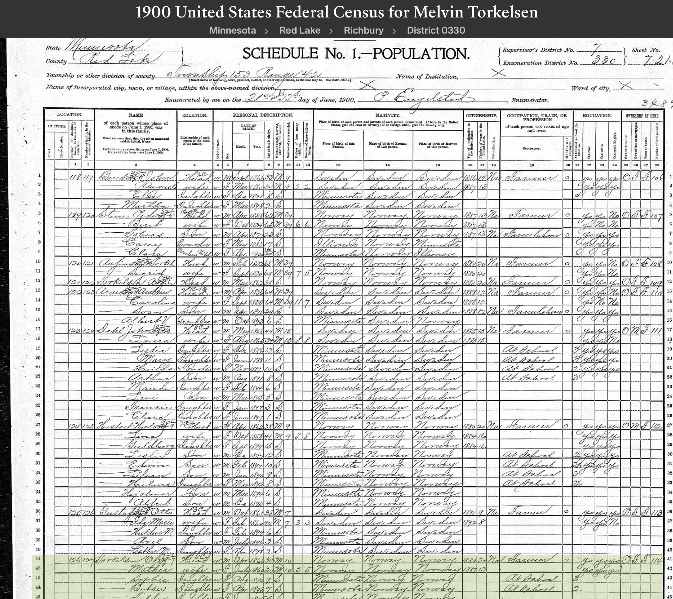
1900 Census
Olaf Torkelson in 1900
All the children use the surname Torkelson
Township 153 is Richbury, not Smiley
This census is a great one for birthdays and the age at which someone was naturalized!

Slide 16
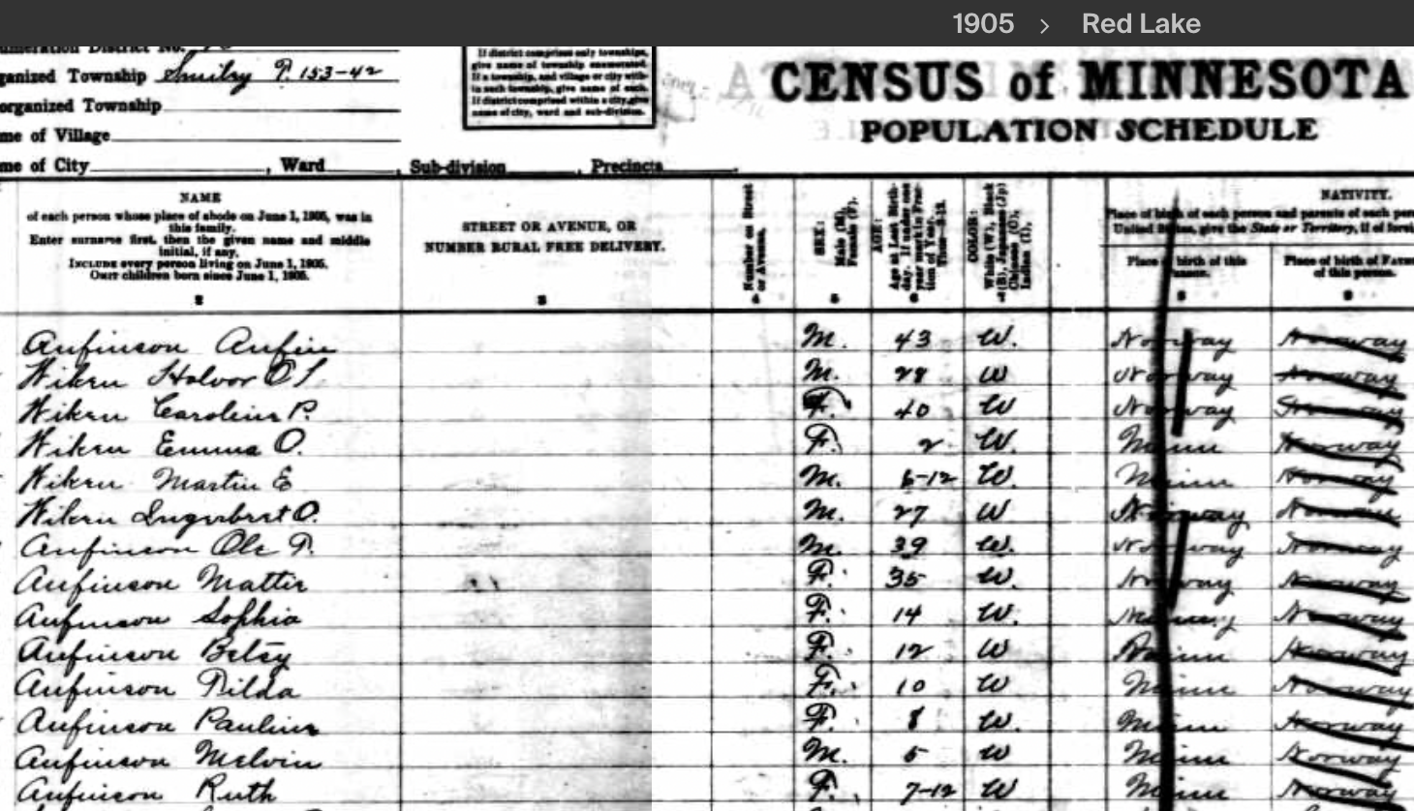
1905 Minnesota Census
Now he’s Ole T. Anfinson and all the children are Anfinsons.

Slide 17
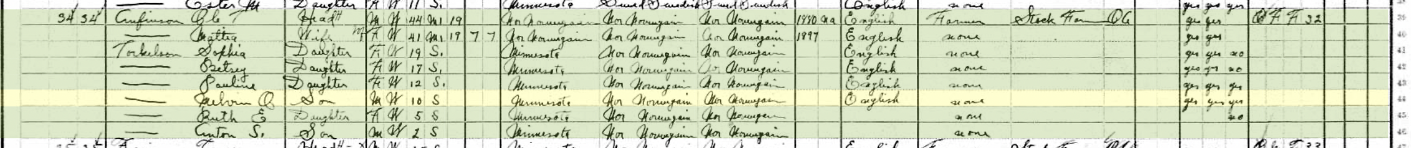
1910 Census
Ole T. Anfinson and his wife have kept their surname but the children are now Torkelsons
Mattia should be Mathea
Betsey will eventually be Bessie

Slide 18
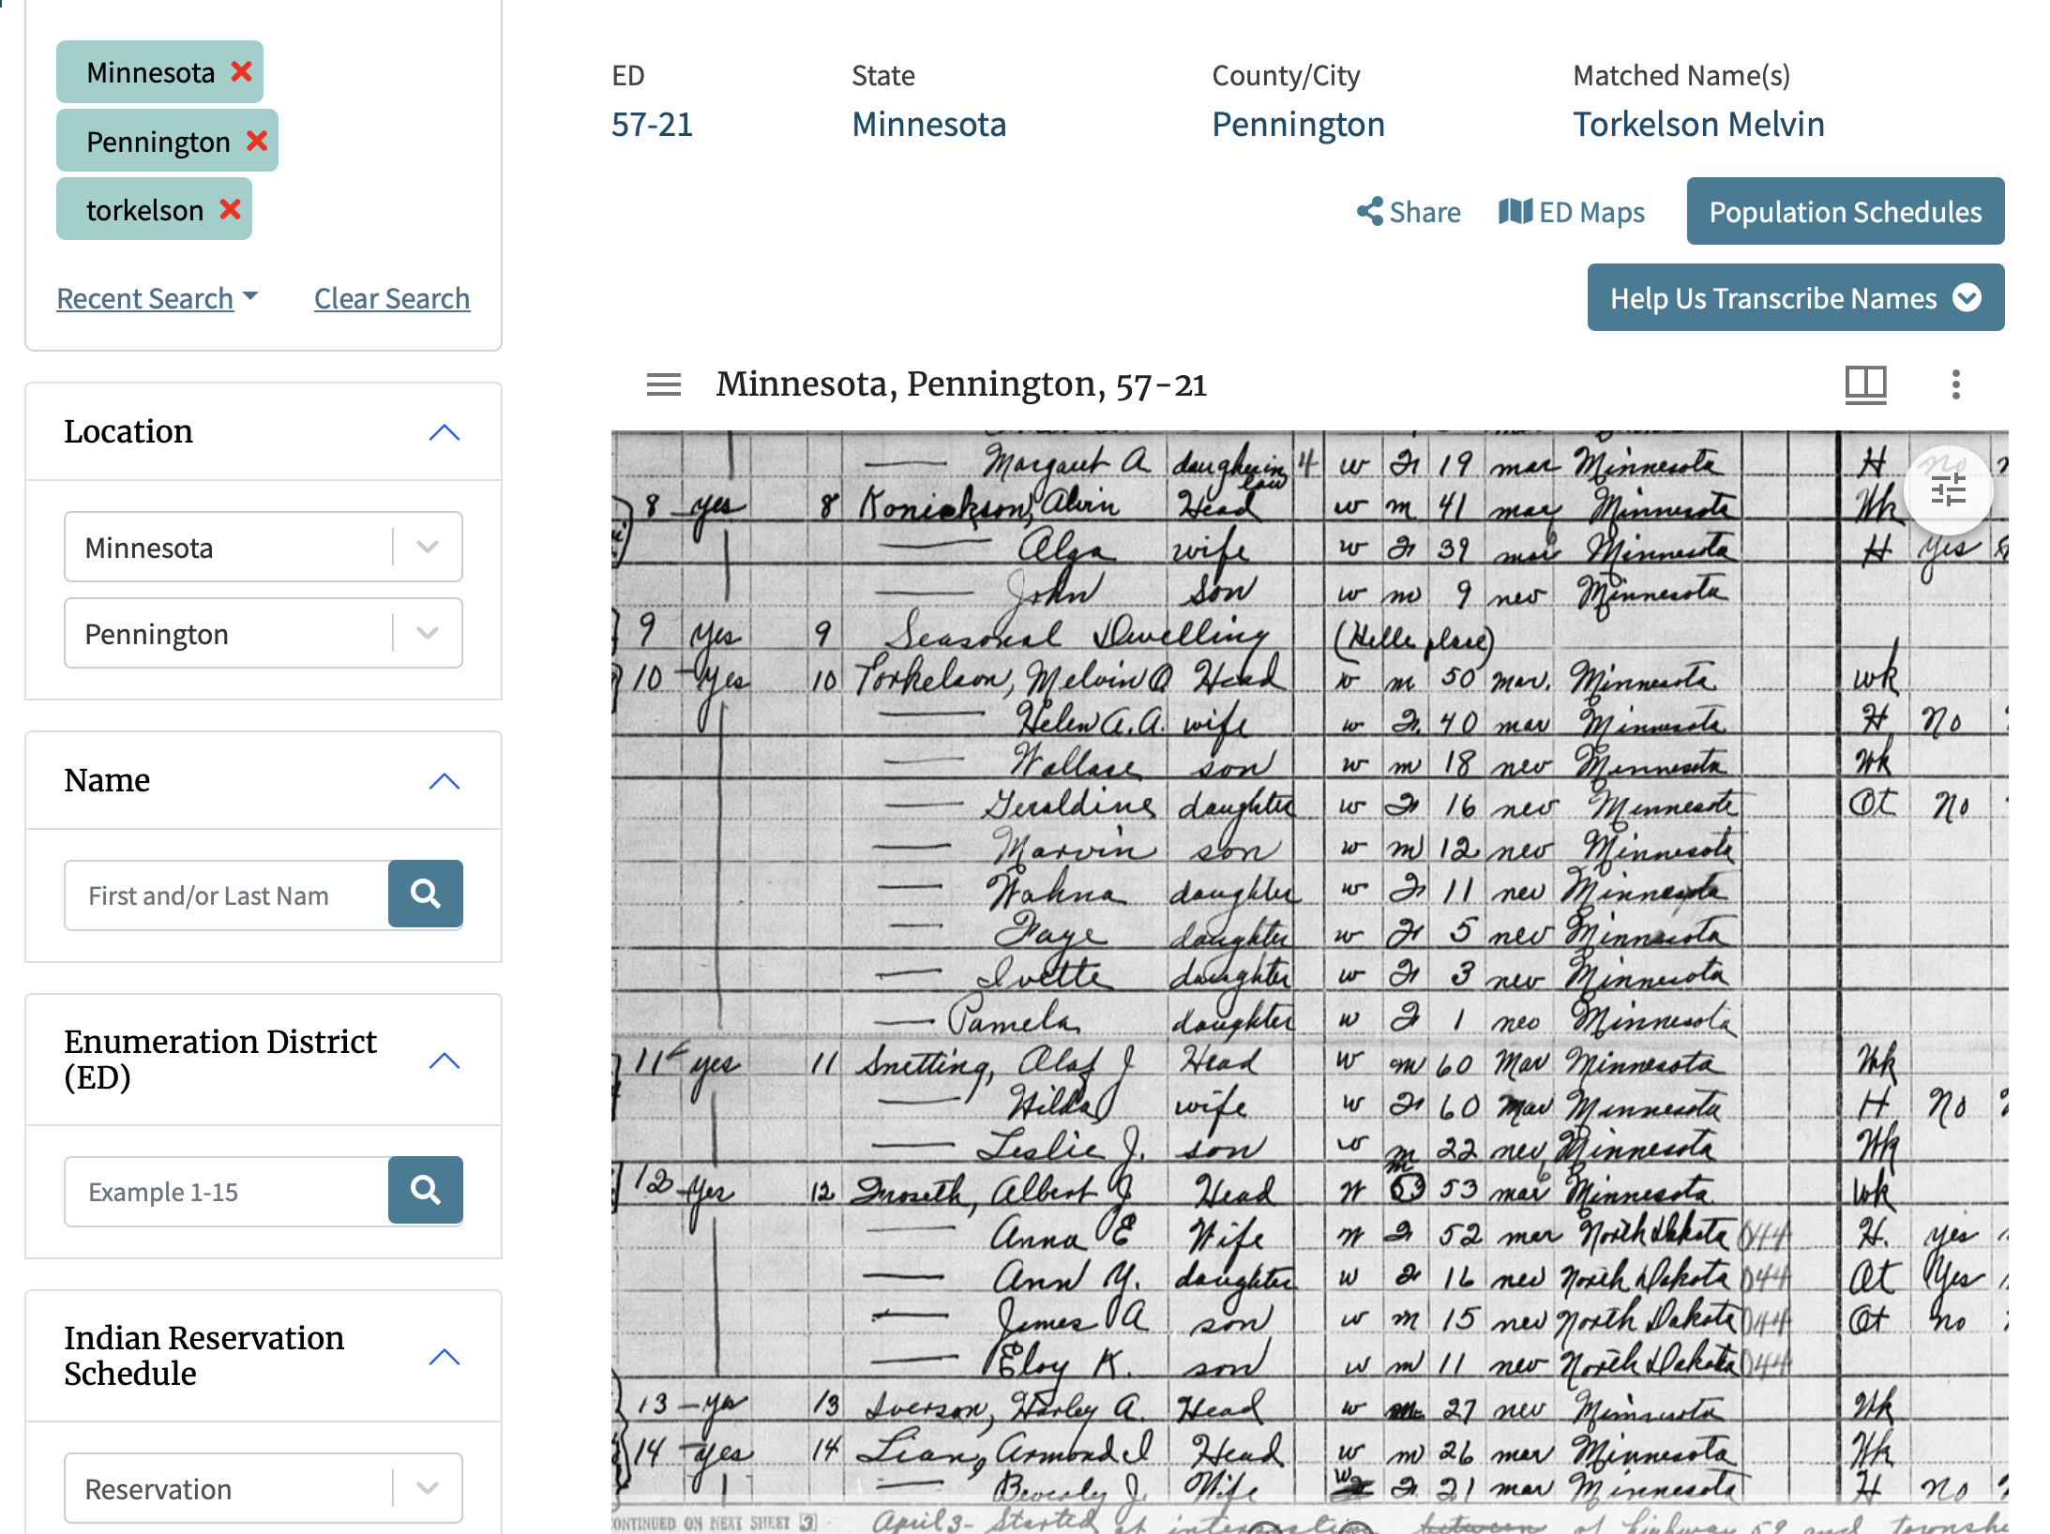
Census Records: archives.gov

Slide 19
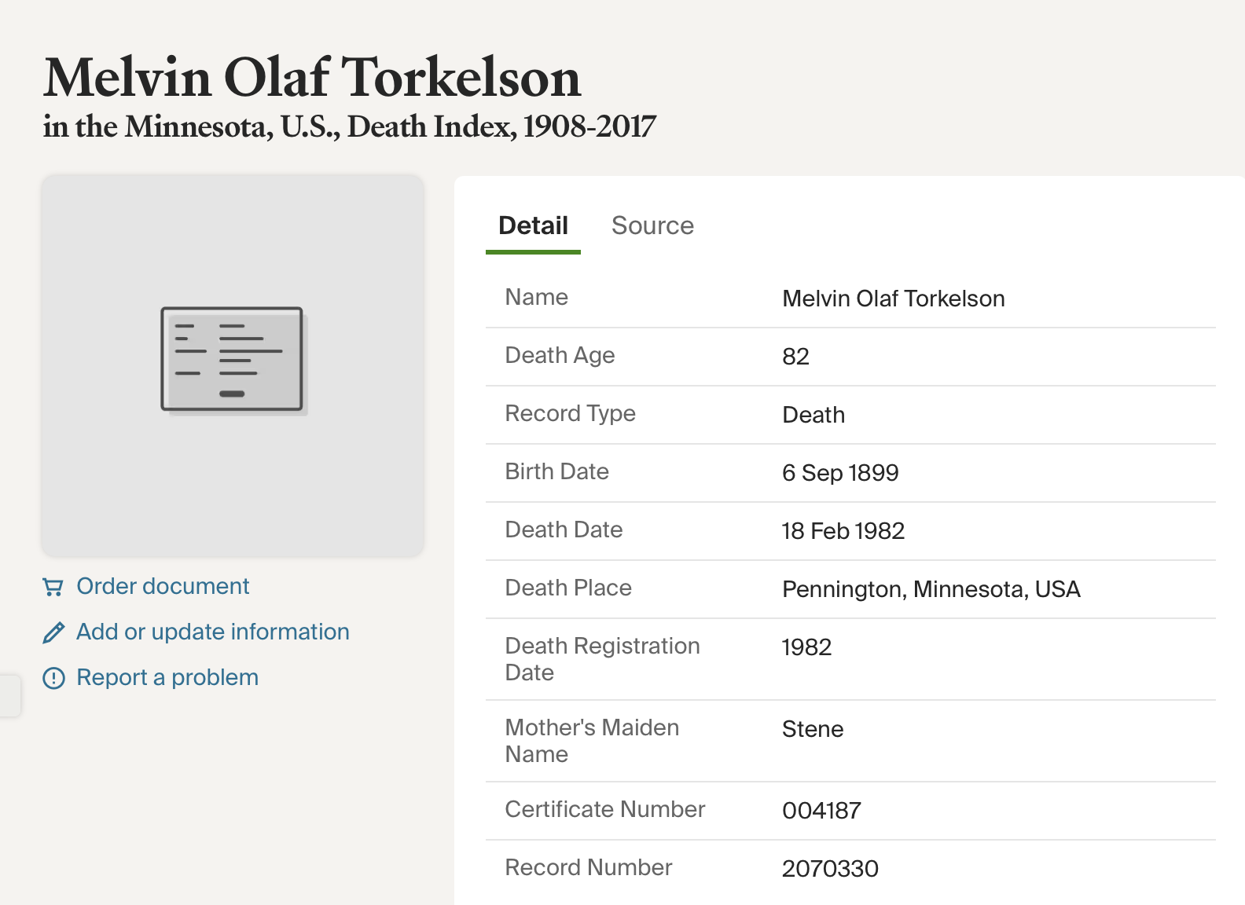
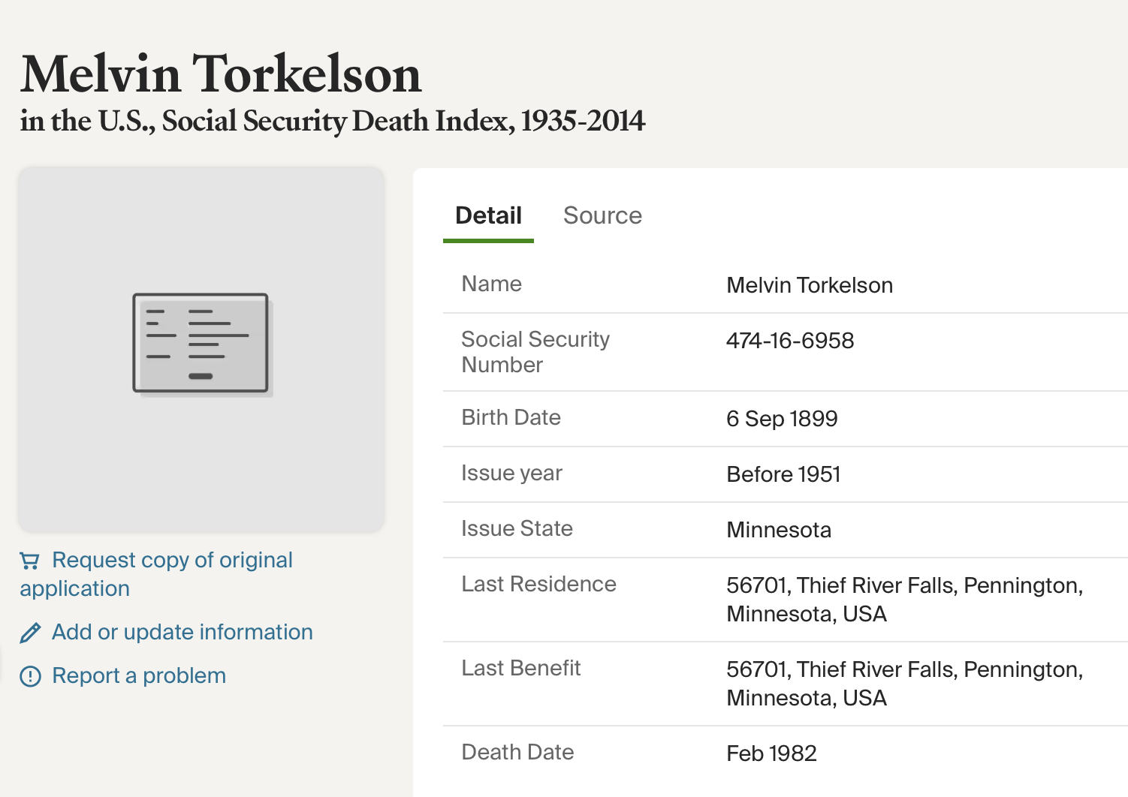
Birth and Death
Minnesota birth records are no longer public

Slide 20
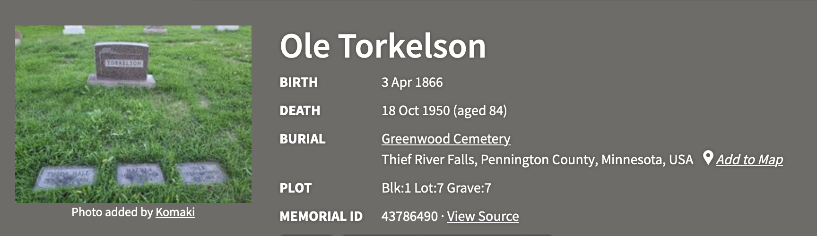
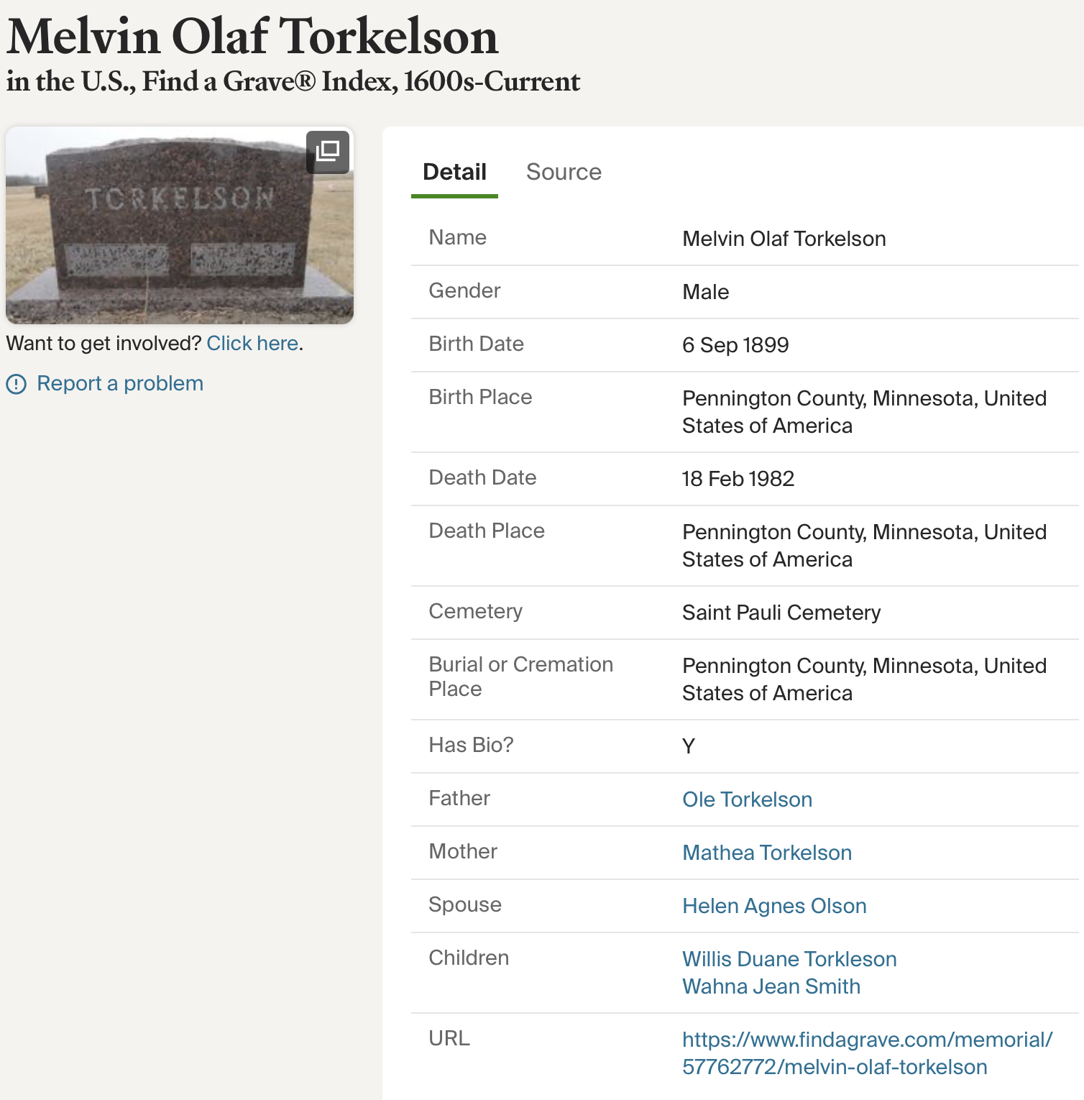
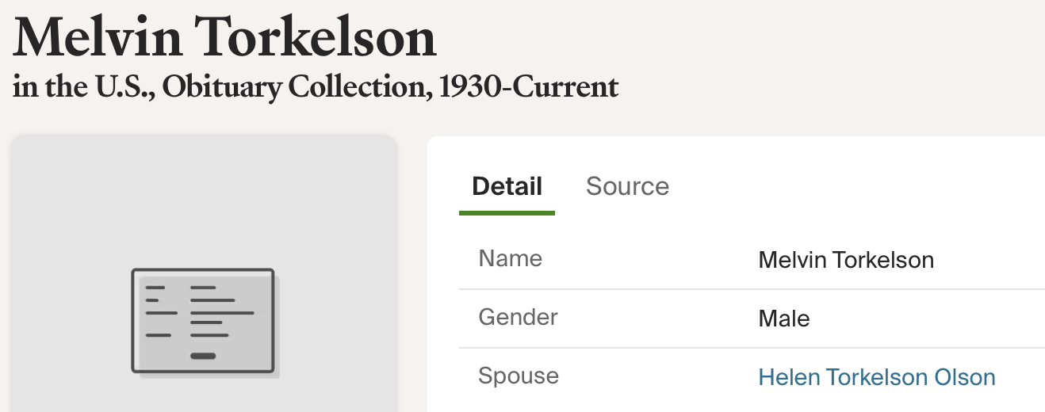
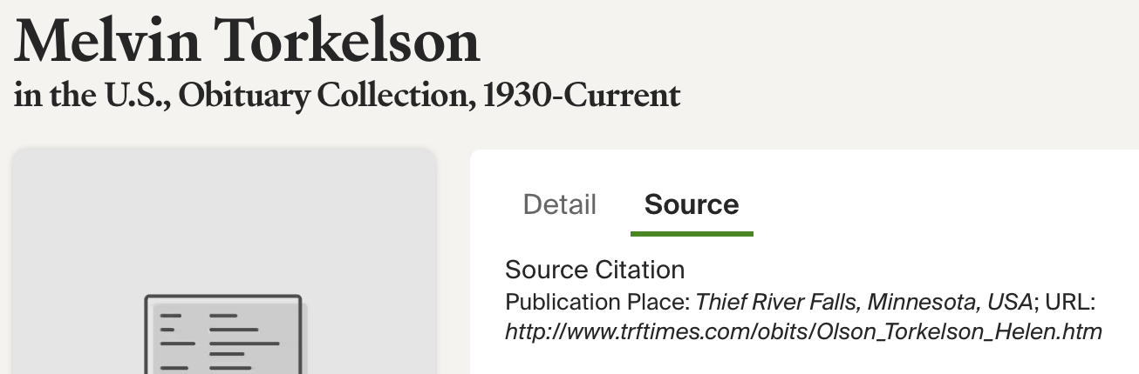
Cemetery Records
Plot numbers can yield family members who are nearby.
No online obituary for Melvin but there was a link for Helen to the TRF Times.

Slide 21
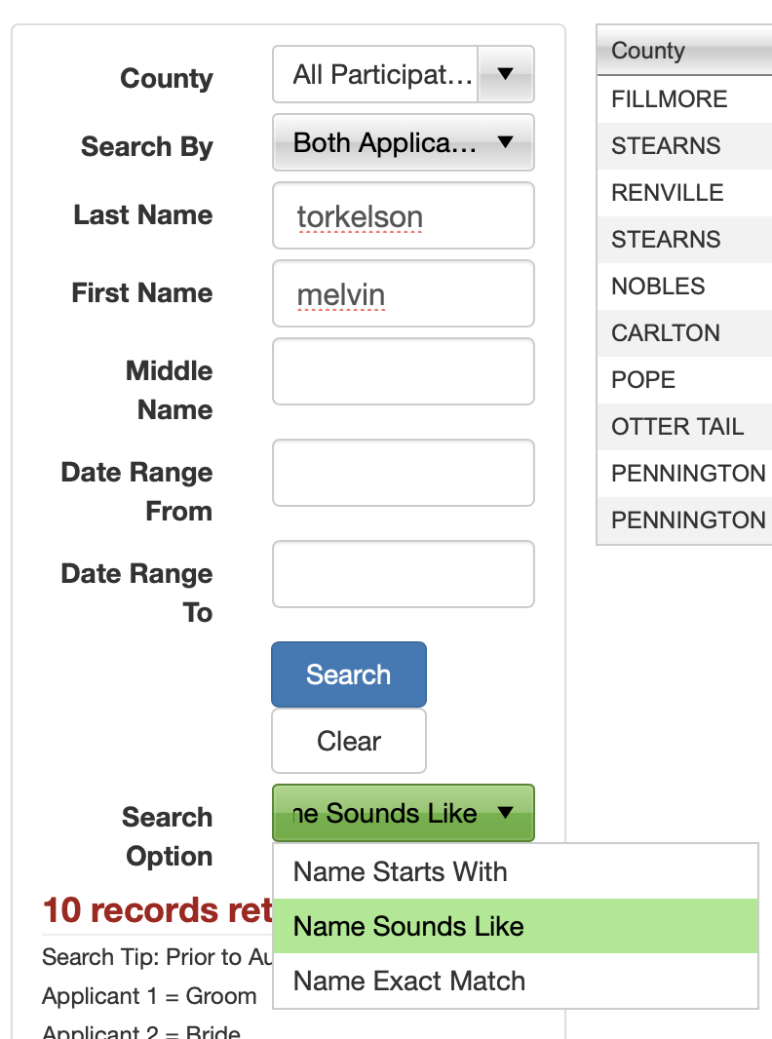
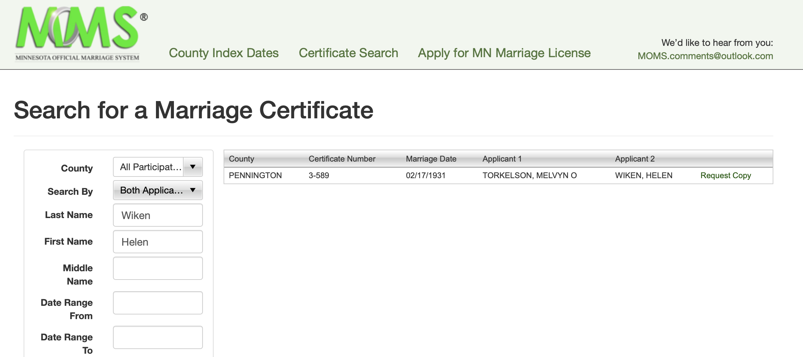
Marriage Records
moms.mn.gov
Searching for Melvin Torkelson yielded no results because he was spelling it Melvyn!
Use “sounds like” or “Soundex”, not an exact match.

Slide 22
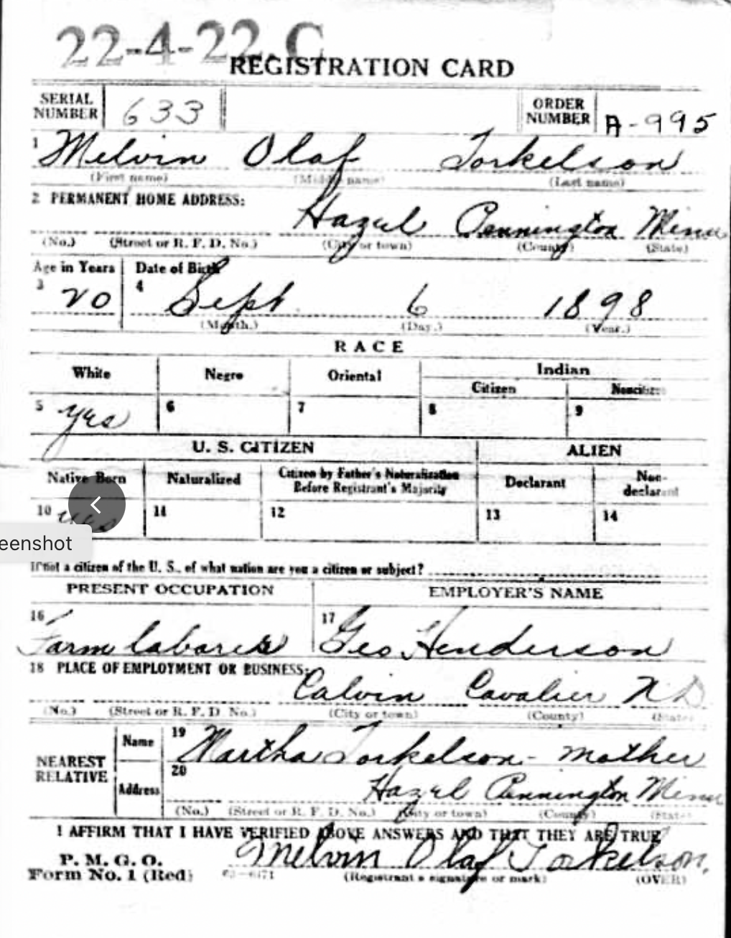
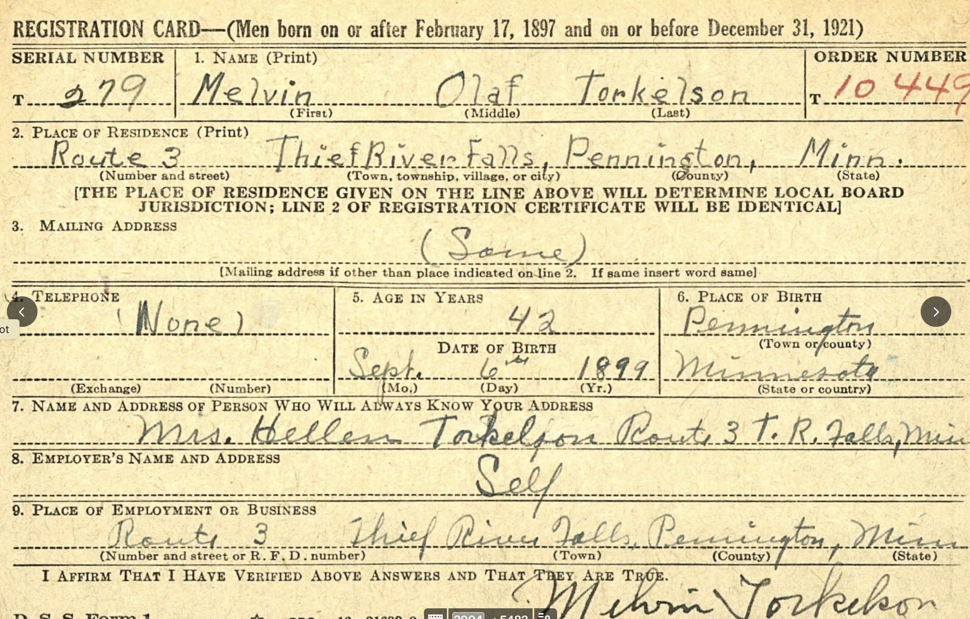
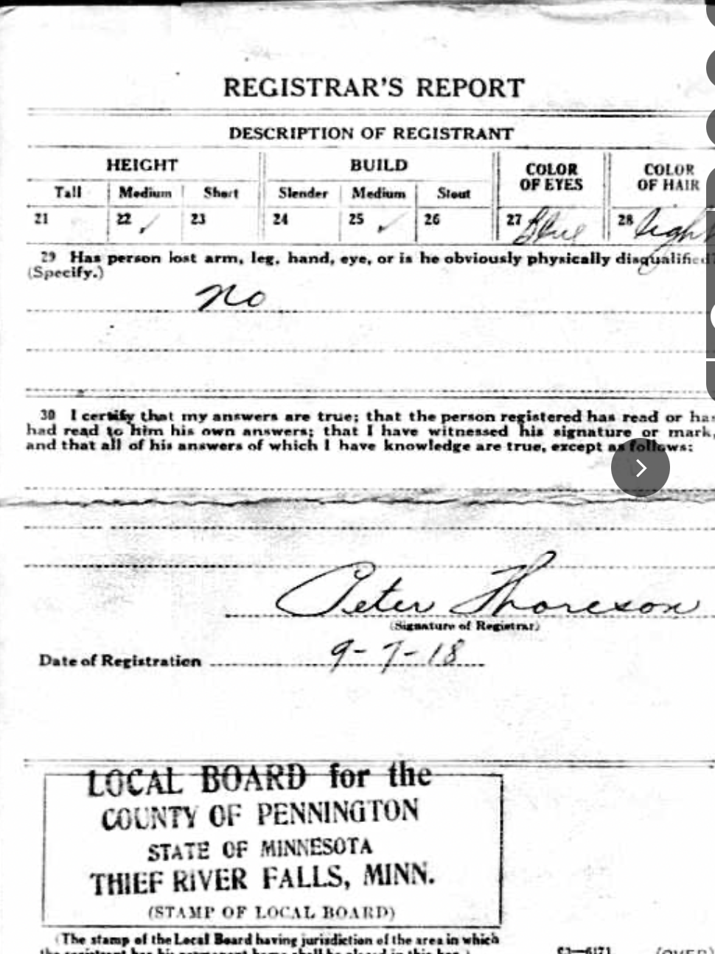
Draft Registration Records

Slide 23
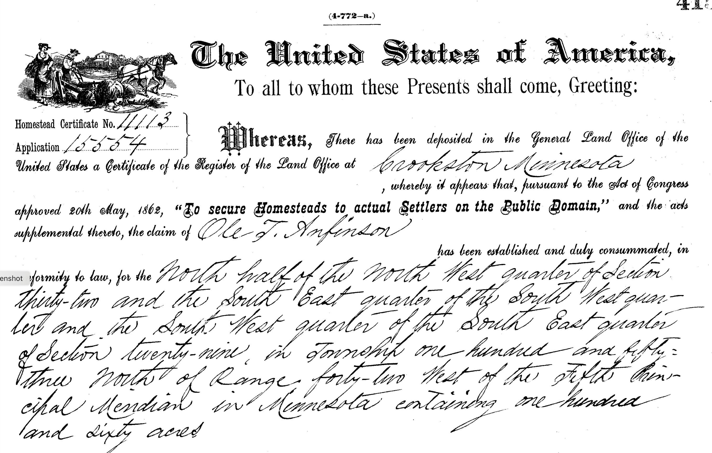
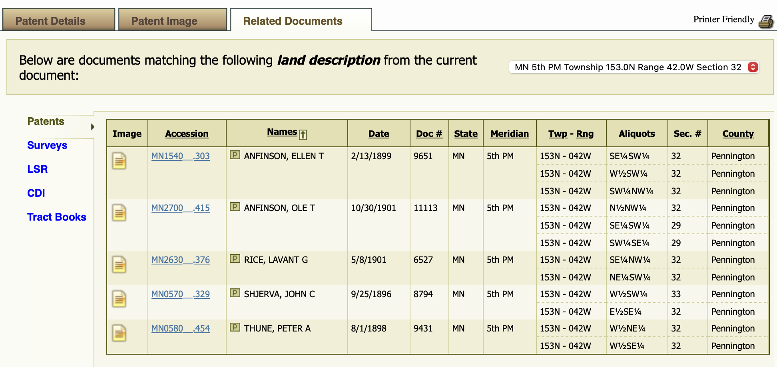
Land Records | glorecords.blm.gov
Related documents for neighbors!

Slide 24
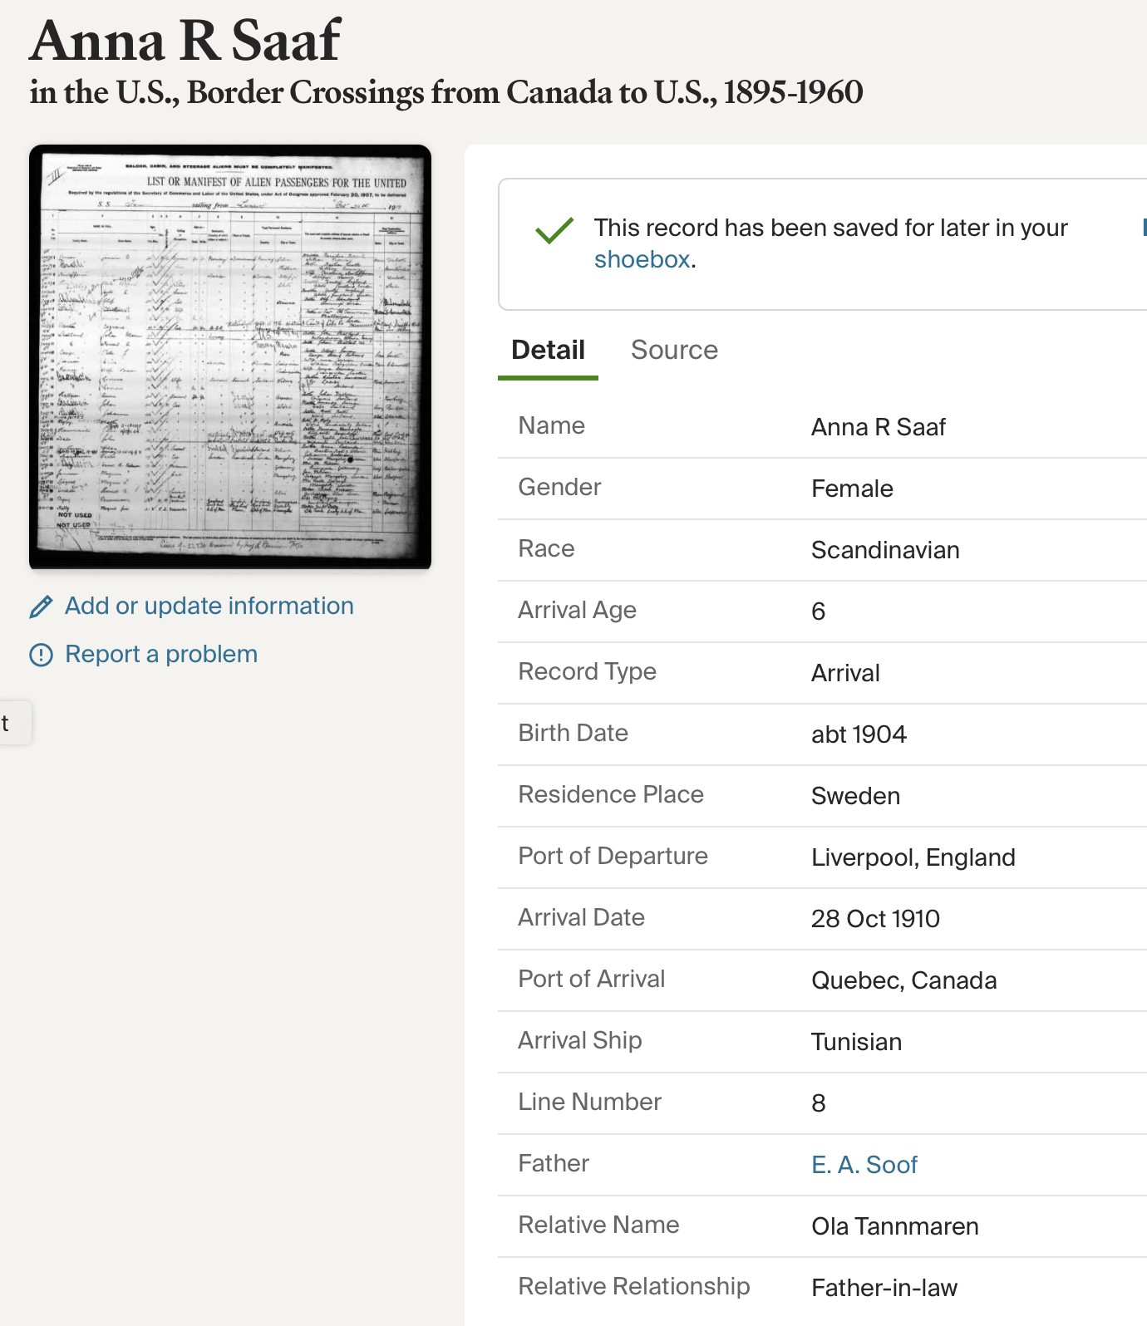
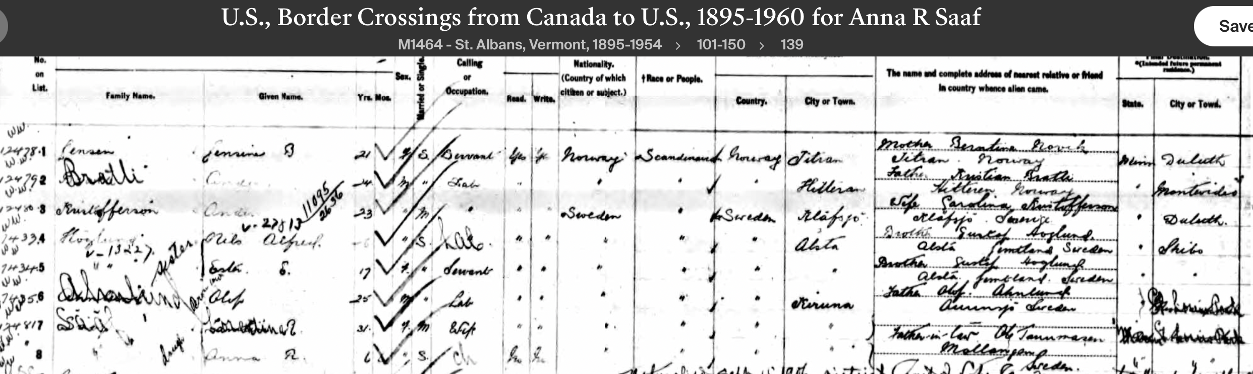
Arrivals
E.A. Soof is the father of Anna R. Saaf?

Slide 25
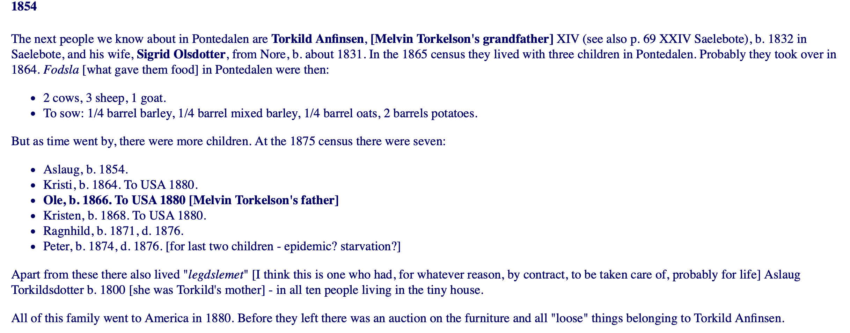
Bygdebøker
https://apps.library.und.edu/bygdebok/research-guide

Slide 26
MarisaAnneBenson.com

